Slide 1
Design Facets of Crowdsourcing
Peter Organisciak, Michael Twidale
organis2@Illinois.edu
Graduate School of Library and Information Science, University of Illinois at Urbana-Champaign
Notes:
Introduction
- Crowdsourcing is a production model where many people, often non-professionals, contribute to a common product.
- pattern is potentially very useful for information science, because the ability for large numbers of diverse people to react to and enrich information items offers new ways to represent them.
- The scope of crowdsourcing is broad, however, and the myriad approaches to collaboration among distributed crowds lend a lack of coherence which may intimidate a practitioner. In order to address this, we present a typology of crowdsourcing for information science.

Slide 2
What is crowdsourcing?
That’s what today is about!
But something to start:
Crowdsourcing refers to collaboration of large numbers of distributed people on a common product, usually organized through information technology.
Notes:
Today we’re going to spend time exploring the different angles of crowdsourcing. Let’s start, however, from a base definition.

Slide 3
Related Concepts
Free and Open Source Software (FOSS)
Commons-based peer production, User innovation
Citizen science
Wisdom of the crowds
Human computation

Slide 4
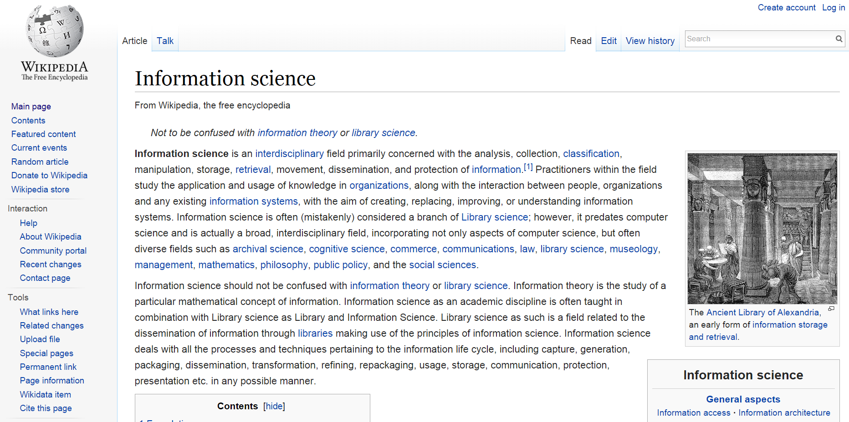
What does crowdsourcing look like?
Notes:
What does crowdsourcing look like?
Wikipedia
Suda Online
Old Weather
What’s on the Menu

Slide 5
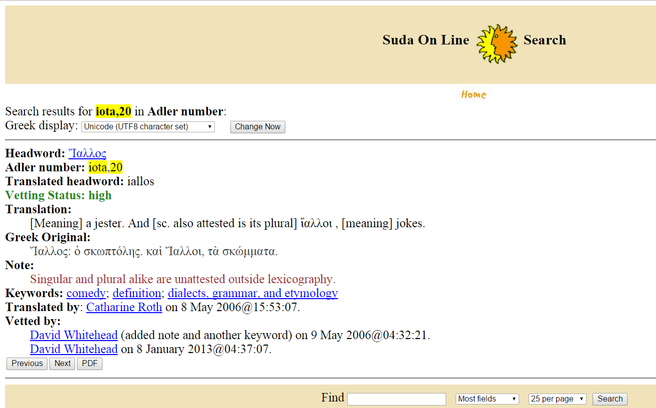
Notes:
What does crowdsourcing look like?
Wikipedia
Suda Online
Old Weather
What’s on the Menu

Slide 6
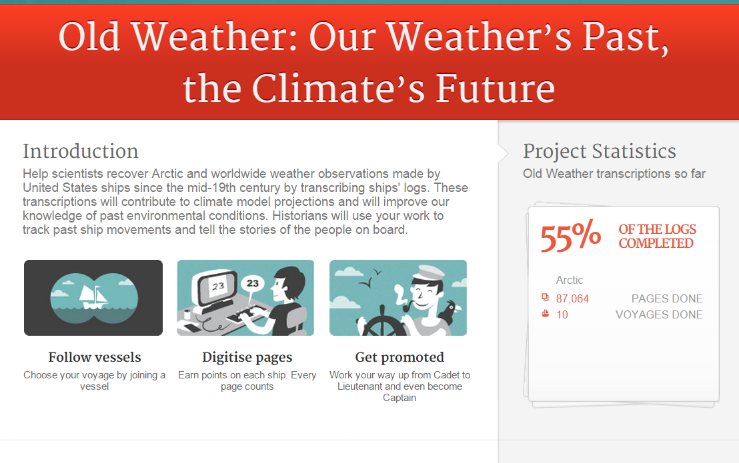
Notes:
What does crowdsourcing look like?
Wikipedia
Suda Online
Old Weather
What’s on the Menu

Slide 7
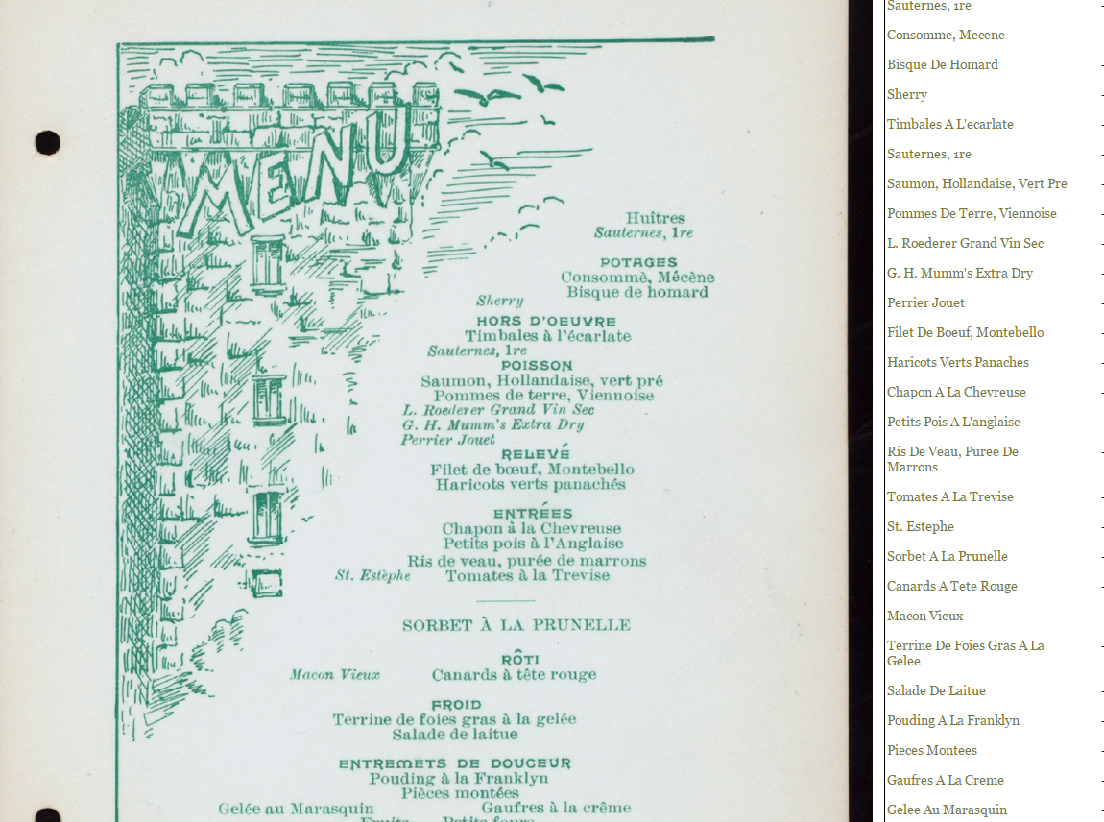
Notes:
What does crowdsourcing look like?
Wikipedia
Suda Online
Old Weather
What’s on the Menu

Slide 8
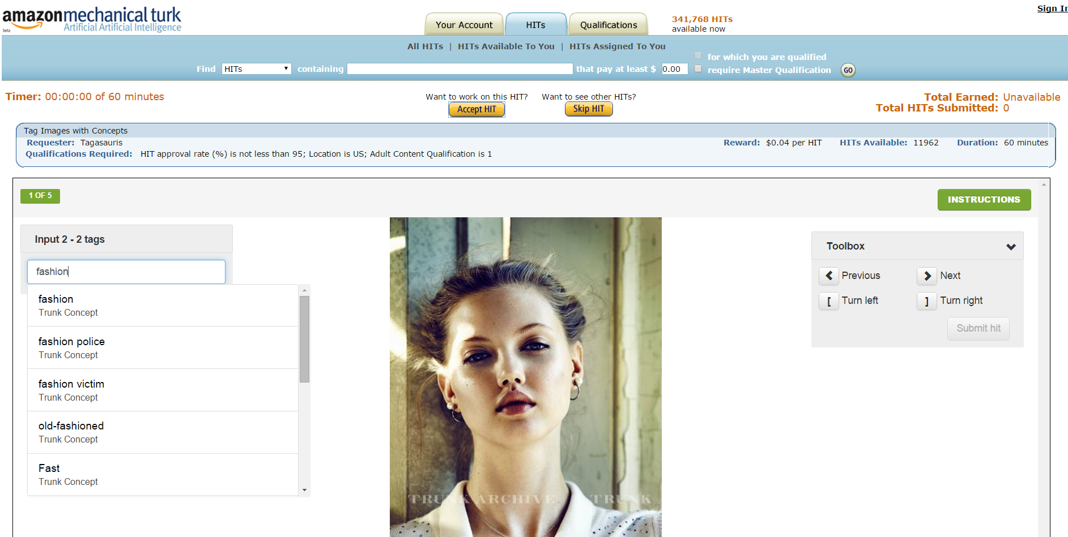

Slide 9
What, where, how
TODAY: A typology for crowdsourcing focusing on meaningful dimensions for information science
Past taxonomic efforts have either done a deep dive into a smaller concept within crowdsourcing* or provided a domain-specific look at crowdsourcing**
We adapt previous work to a user-centric frame, augmented by empirically observed dimensions not noted earlier and earlier content analysis work
* e.g. Wiggins and Crowston 2012 on citizen science; Quinn and Bederson 2011 on human computation
** e.g., Geiger, Seedorf, Schulze, Nickerson, & Schader, 2011; Vukovic & Bartolini, 2010; Schenk & Guittard, 2009; Rouse, 2010
Notes:
- Like many such efforts, this is emerged from a need related to my dissertation research
- 2) particularly in business and economics

Slide 10
The (intended) takeaway
An understanding of the various ways that information systems can collaborative with online crowds
Notes:
Today is about breadth: I want you to understand possibility
- Let’s be honest: a typology is difficult to present adequately in 20min, there is no ‘1 takeaway’, but I’lltry my test to help you in getting the wheels turning for how you can interact with crowds

Slide 11
An IS-centric Typology of Crowdsourcing

Slide 12
Questions
Who contributes? What are their skills?
How are contributors motivated?
What do contributions look like? What is the style of contribution and how is it kept?
Who is asking? Who is benefiting?
Is the contribution indirect or manifest?
Is it central to the system?
How is quality controlled for?

Slide 13
Questions
Motivation | How are contributors incentivized?
Centrality | How central is the crowdsourcing to the overall project?
Beneficiary | Who benefits? What is their relationship to contributors?
Aggregation | How are diverse contributions reconciled into a common product?
Type of Work | What is the nature of the work?
Type of Crowd | What are the dimensions of the crowd and how they are expected to perform?

Slide 14
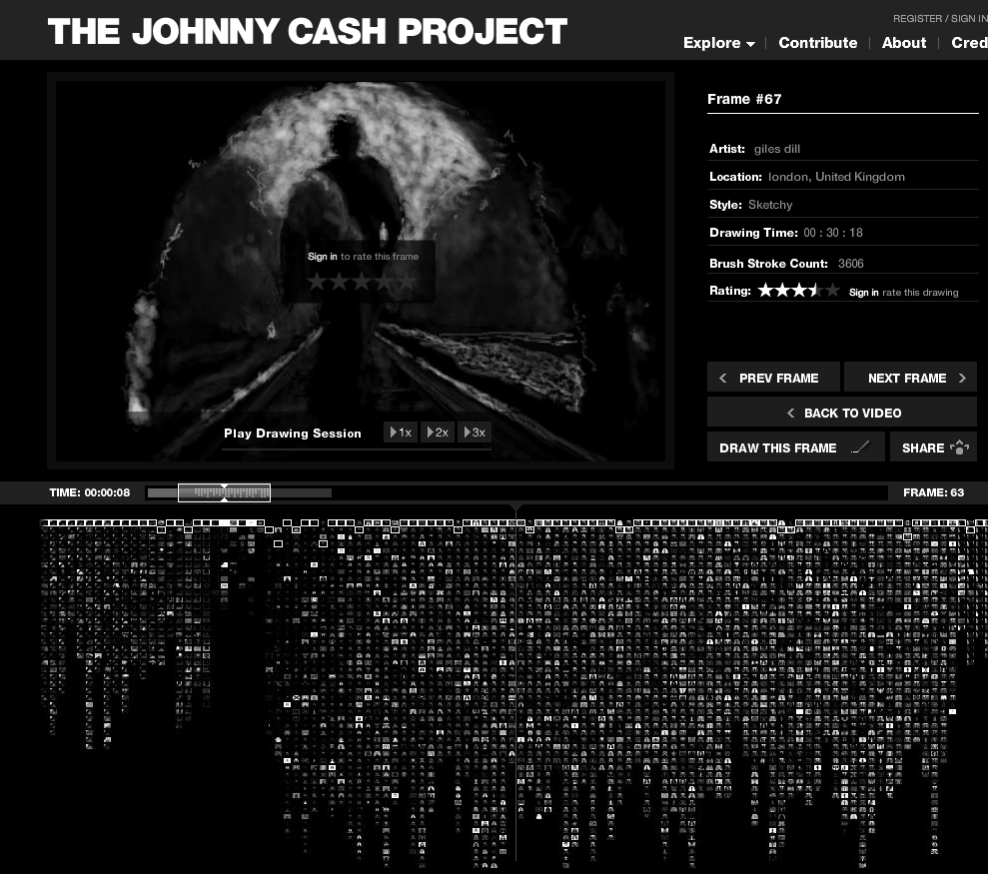
Type of Work
Human computation—Creative
Notes:
HC – “the problems fit the general paradigm of computation, and as such might someday be solvable by computers”
(Quinn & Bederson, 2011).
- Understanding that crowdsourcing is not solely human computation tasks, the
inferred corollary to these types of tasks are those that are expected to be too complex for computers: creative,
judgment-based, or requiring critical thinking.

Slide 15
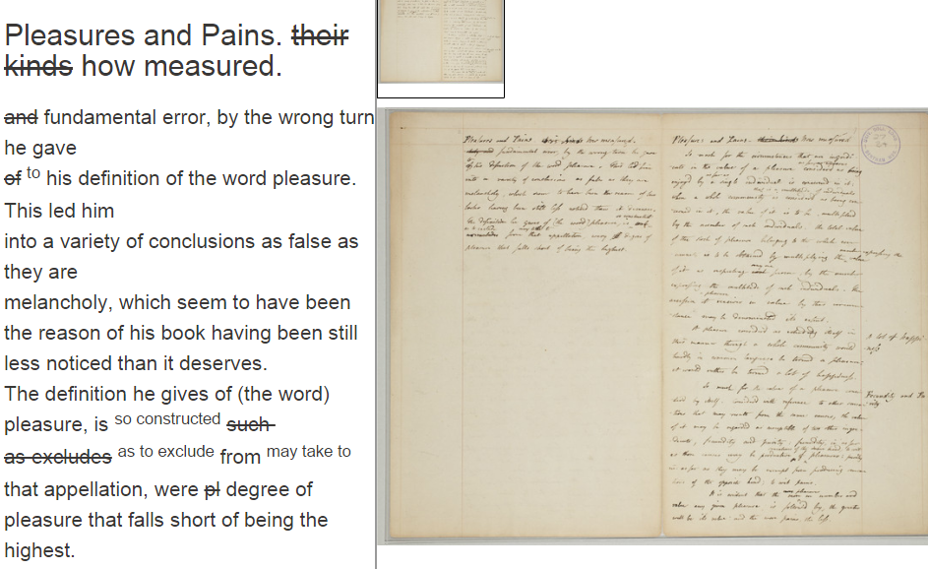
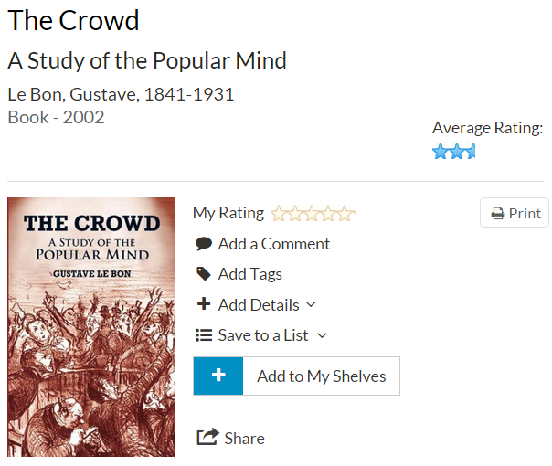
Type of Work
Crowdsourcing Metadata
Generative—Reactive
Notes:
The distinction is whether you’re creating a new information object, or contributing to metadata
This distinction is not addressed in other views of crowdsourcing, but it is really important in IS.
2) Transcription 3) Ratings

Slide 16
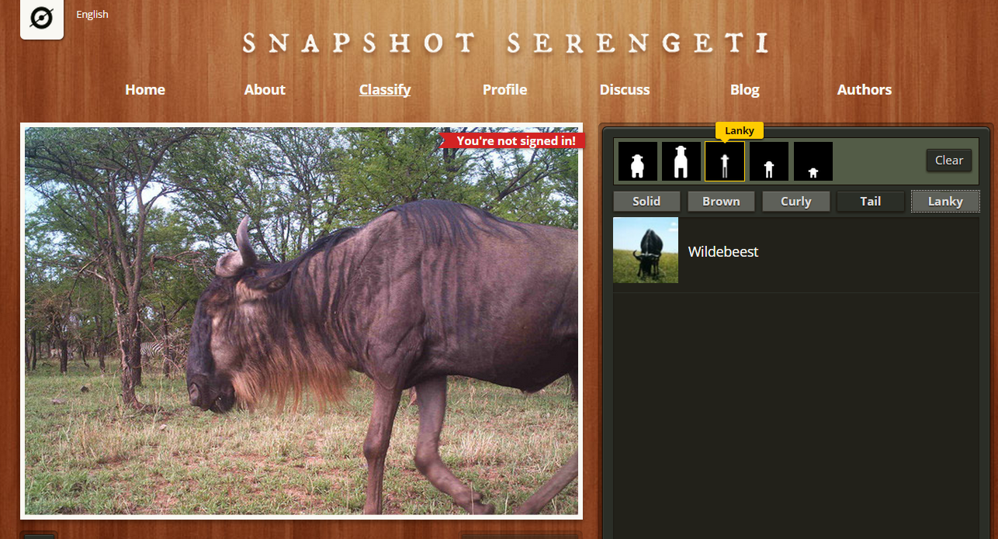

Type of Work
Subjective—Objective

Slide 17
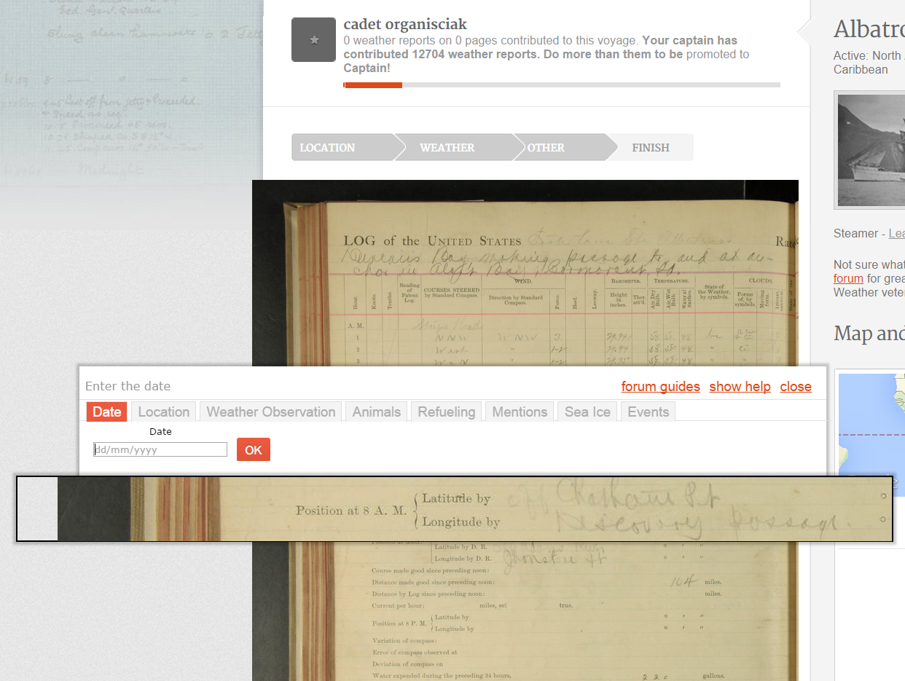
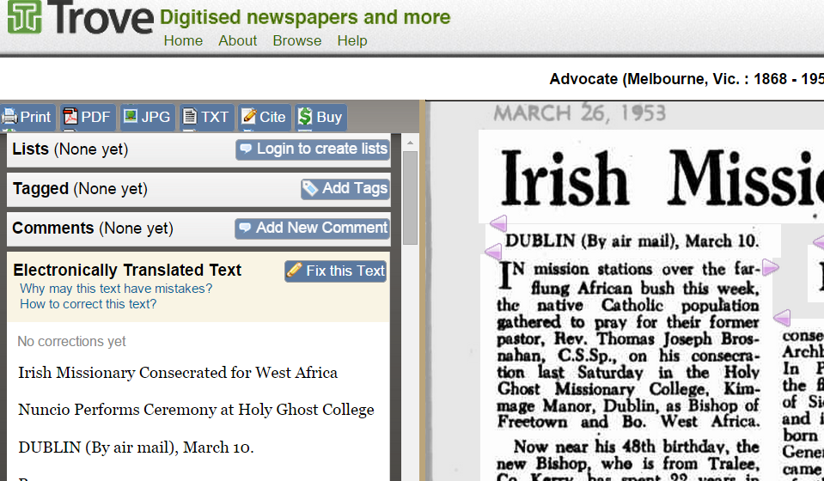
Centrality
Peripheral — Core
Notes:
Not all

Slide 18
Type of Crowd
Necessary skills
unskilled, locally trained, specialized
Diversity
Diverse—Homogeneous
Notes:
- When online players compete to fold proteins in the most efficient way possible for FoldIt, the project’s success is predicated on the ability of people to
problem-solve in variable ways
-

Slide 19
Beneficiary
Autonomous vs sponsored (Zwass 2010)
Is there an entity on top, a client? Or is the value in the commons, as with Wikipedia?
Shared goals or individual goals?
crowd vs. collective
Relationship between contributor and director
Both benefit (symbiosis), one benefits at the expense of the other (parasitism), both benefit in different ways (commensalism)

Slide 20
Motivation
Intrinsic /Extrinsic factors (Ryan & Deci, 2000)
Volunteer/paid crowdsourcing
Types of payment: fixed remuneration, pre-agreed fee, success-based payment (Geiger et al 2011)
Notes:
Not an exact mapping (e.g. see Mason and Watts)

Slide 21
Primary / Secondary Motivators
Similar to Kraut and Resnick (2011) focus on encouraging contribution / commitment
Money and extrinsic reward
Interest in the topic
Ease of entry and ease of participation
Altruism and meaningful contribution
Sincerity
Appeal to knowledge and opinions
Notes:
classified 300 crowdsourcing website, purposively sampled 13 sites from class strata, and performed user studies on those sites
also overlaps with Encouraging contribution/commitment (Kraut and Resnick 2011)

Slide 22
Primary / Secondary Motivators
Similar to Kraut and Resnick (2011) focus on encouraging contribution / commitment
Money and extrinsic reward
Interest in the topic
Ease of entry and ease of participation
Altruism and meaningful contribution
Sincerity
Appeal to knowledge and opinions
Notes:
classified 300 crowdsourcing website, purposively sampled 13 sites from class strata, and performed user studies on those sites
also overlaps with Encouraging contribution/commitment (Kraut and Resnick 2011)

Slide 23
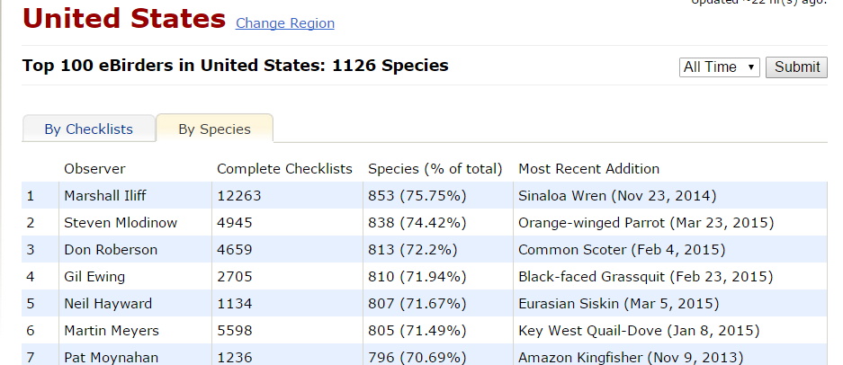
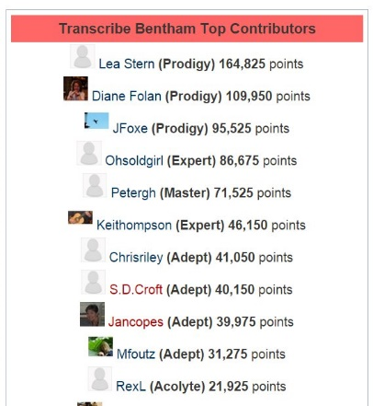
Primary / Secondary Motivators
Similar to Kraut and Resnick (2011) focus on encouraging contribution / commitment
Money and extrinsic reward
Interest in the topic
Ease of entry and ease of participation
Altruism and meaningful contribution
Sincerity
Appeal to knowledge and opinions
Notes:
classified 300 crowdsourcing website, purposively sampled 13 sites from class strata, and performed user studies on those sites
also overlaps with Encouraging contribution/commitment (Kraut and Resnick 2011)

Slide 24
Primary / Secondary Motivators
Similar to Kraut and Resnick (2011) focus on encouraging contribution / commitment
Money and extrinsic reward
Interest in the topic
Ease of entry and ease of participation
Altruism and meaningful contribution
Sincerity
Appeal to knowledge and opinions
Novelty (don’t count on this)
“[Flickr Commons] appears to have tapped into
the Web community’s altruistic substratum by asking people for help. People wanted to participate and liked being asked to contribute” (Springer et al. 2008)
Notes:
classified 300 crowdsourcing website, purposively sampled 13 sites from class strata, and performed user studies on those sites
also overlaps with Encouraging contribution/commitment (Kraut and Resnick 2011)

Slide 25
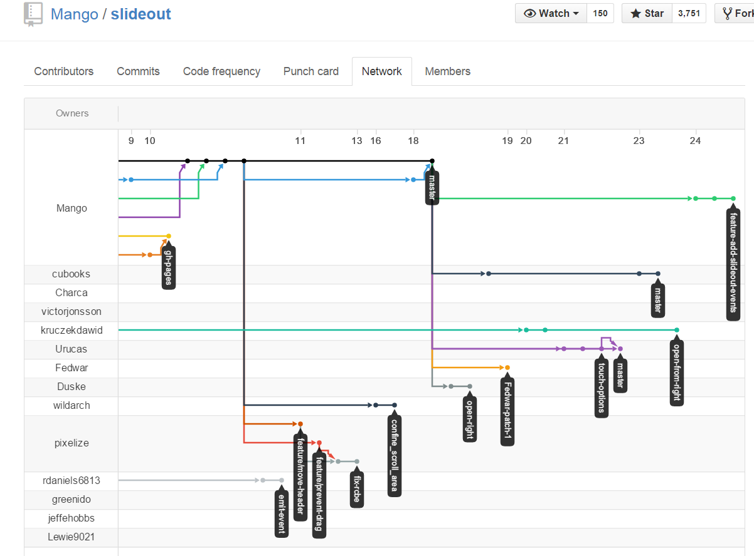
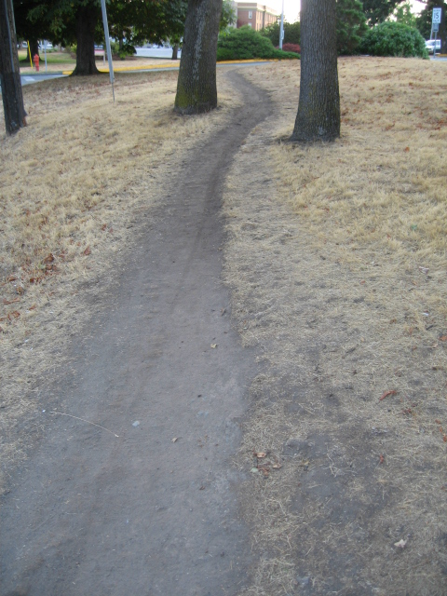
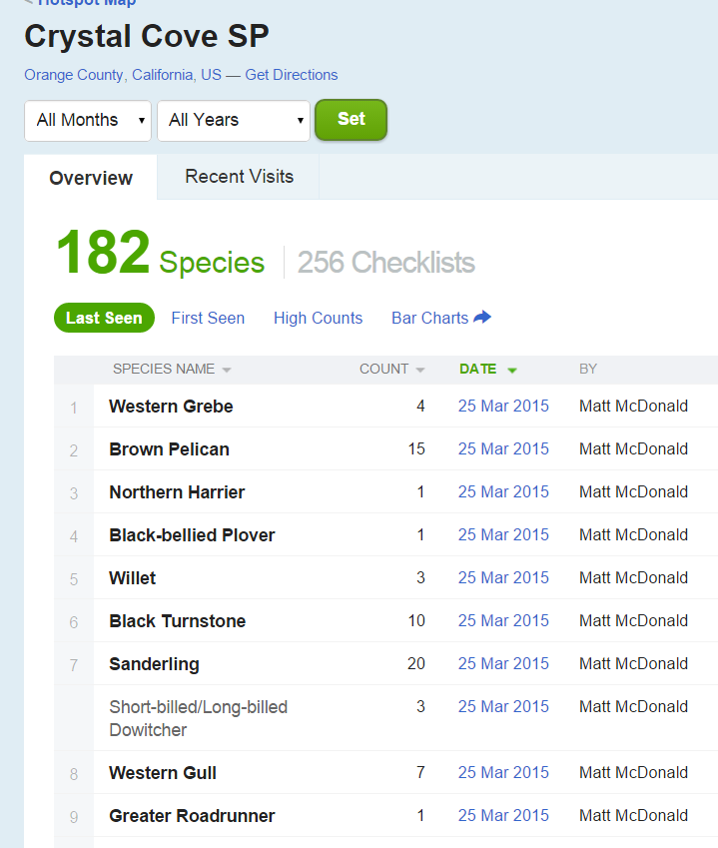
Aggregation
Summative | Iterative | Averaged
Contributions exist in individual form, but contribute to a base of information e.g. reviews | Contributions are permutations of common work e.g. wikis | Contributions are pooled by some consensus-seeking process e.g. ratings
Notes:
Quinn and Bederson, in the context of Human Computation, frame this in the context of quality control.
another iterative example: Turk Best Practices guidelines
desire path

Slide 26
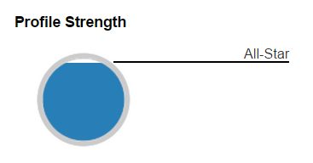
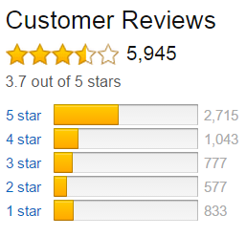
Design Patterns
Microtasking
Gamification
Opinion ratings
Platforms
Contests
Wisdom of crowds

Slide 27
Other issues in crowdsourcing
Data quality
Proper task design
Ownership
Ethics

Slide 28
In Sum
Crowdsourcing is an interesting space, but it’s a big one
Scoping crowdsourcing against dimensions of motivation, type of work, type of crowd, worker-director relationship, centrality, and aggregation helps position projects relative to their contemporaries
Notes:
So, what do you I want you to take away from this?

Slide 29
Thank You
Paper: http://hdl.handle.net/2142/73640 Contact: organis2@Illinois.edu
Motivation | Primary/Secondary (Organisciak, 2010), Contribution/commitment (Kraut & Resnick, 2011) Extrinsic/Intrinsic
Centrality | Core / Peripheral (Organisciak, 2013)
Beneficiary | Autonomous / sponsored (Zwass, 2010) Crowd / individual
Aggregation | Selective /Integrative (Geiger et al., 2011; Schenk & Guittard, 2009) Summative / Iterative / Averaged
Type of Work | Human computation / Creative Generative / Reactive Subjective / Objective
Type of Crowd | Unskilled, locally trained, specialized heterogenous / diverse
Notes:
Read the paper, which also includes Practitioner questions and a look at crowd design patterns

